Slide 1
X-section U-V
See Cross section locations.kmz & Cross section labels.kmz for location in Google Earth

Slide 2
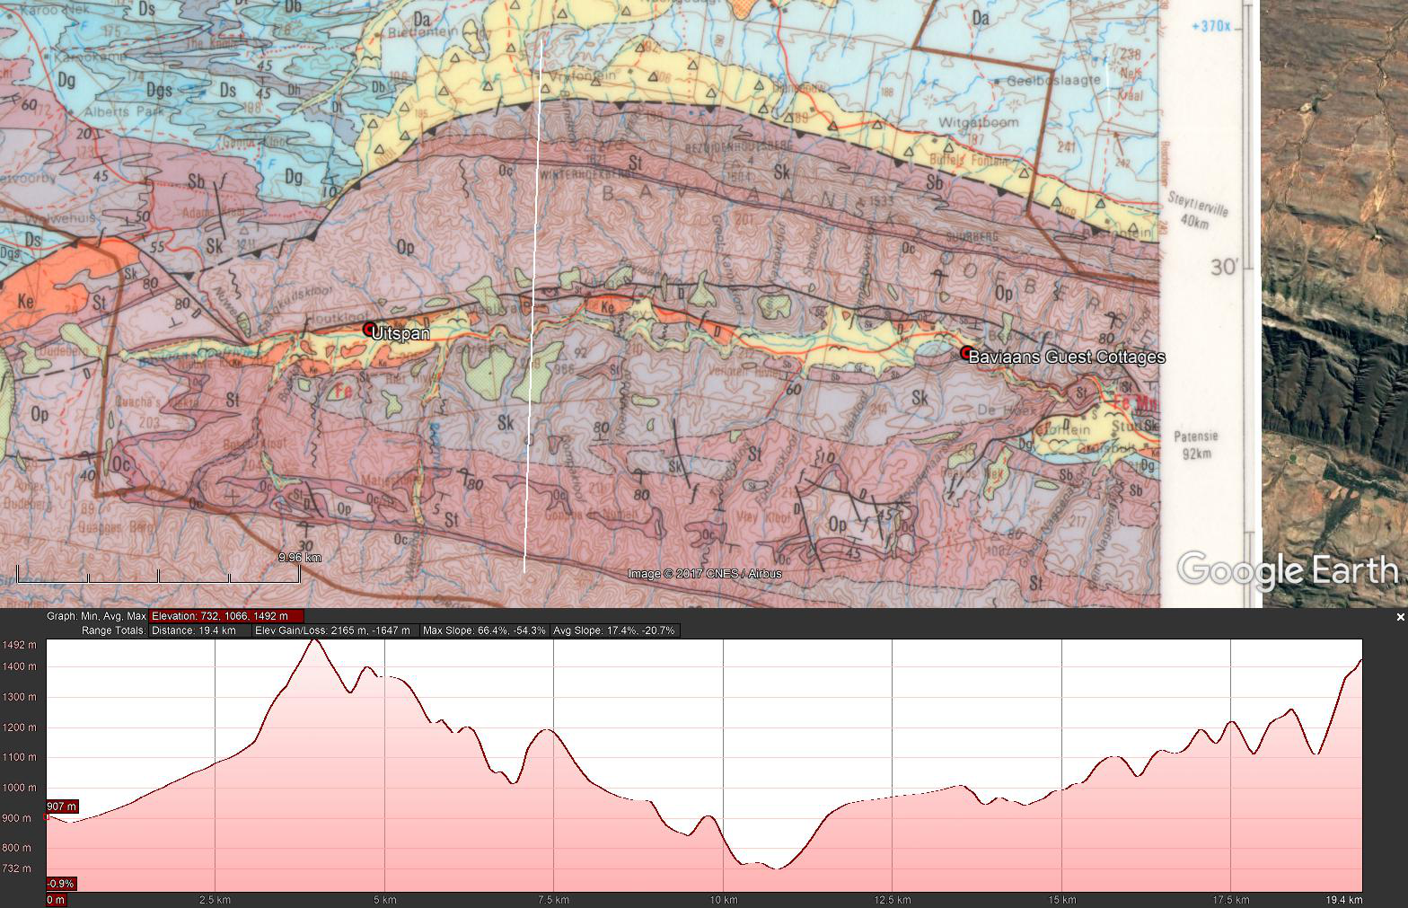
U
Duiwelskloof Lodge
V
masl
N-S Geologic Sketch Section U-V Through Duiwelskloof Showing the Thrust
1 400
Duiwelskloof Lodge
1 400
Thrust
Sk
1 200
St
1 200
Sb
Op
African Erosion Surface
1 000
Da
Sk
1 000
St
Sk
St
Op
800
Db
Sb
800
Ds
St
600
Dgs
Oc
600
Dt
Dg
Op
400
Dh
N
400
200
Sb
Sk
St
Op
N
200
Ds
U
V

Slide 3
Working slides

Slide 5
Duiwelskloof Lodge

Slide 6
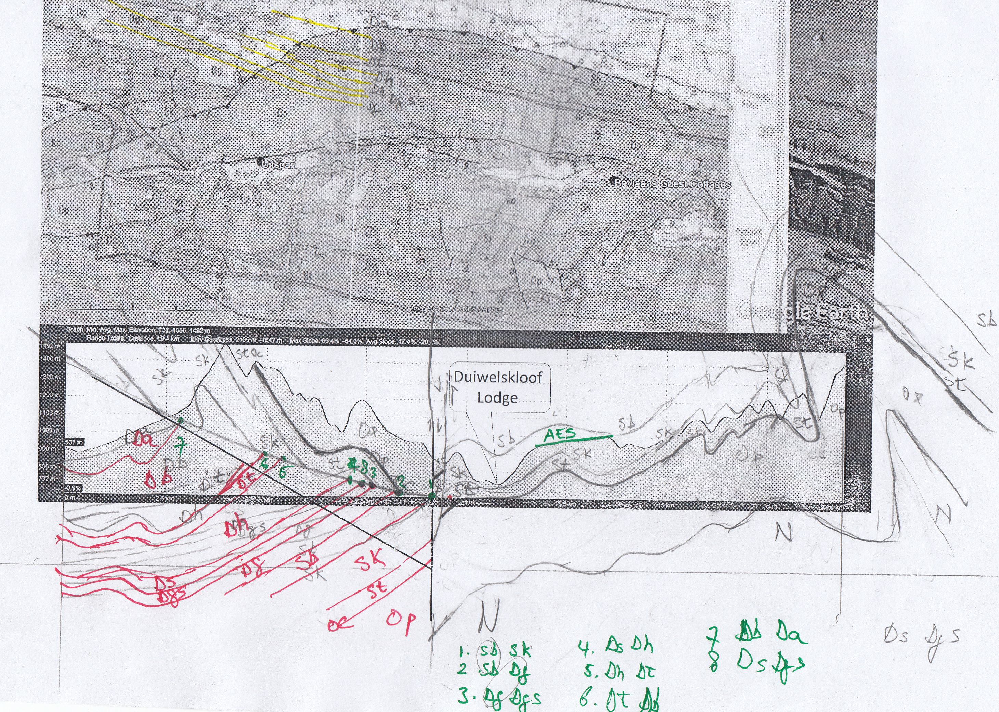
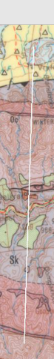
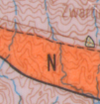


Slide 8
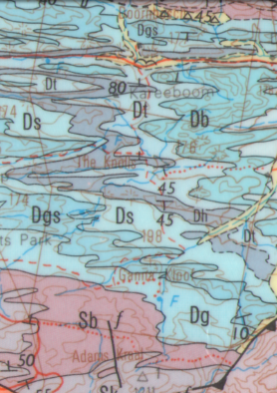
Da
Db
Dt
Dgs
Dh
Dg
Ds
Sb
Sk
St

Slide 9
N = U
N
S = V
S
Thrust
Sk
Duiwelskloof Lodge
Sb
Op
St
Da
St
Op
Db
Sk
Sk
Dgs
St
Oc
Dt
Dg
Op
Dh
N
Ds
Sb
Sk
St
N

